Slide 1
Coffee Quality Dashboard
Analysis of Coffee Quality Data
Kuheli Das
21-05-2024

Slide 2
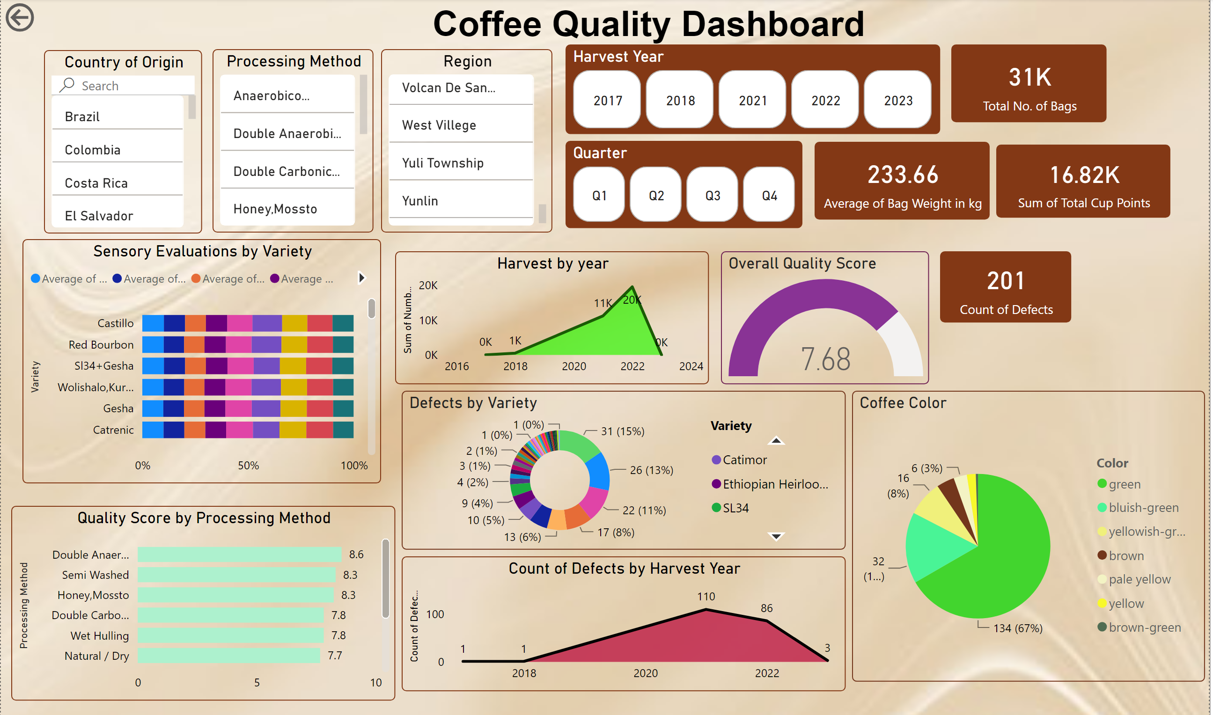
Dashboard Overview
This dashboard provides an overview of coffee quality data including metrics such as Total No. of Bags, Average Bag Weight in kg, Sum of Total Cup Points, Count of Defects, and Overall Quality Score.

Slide 3
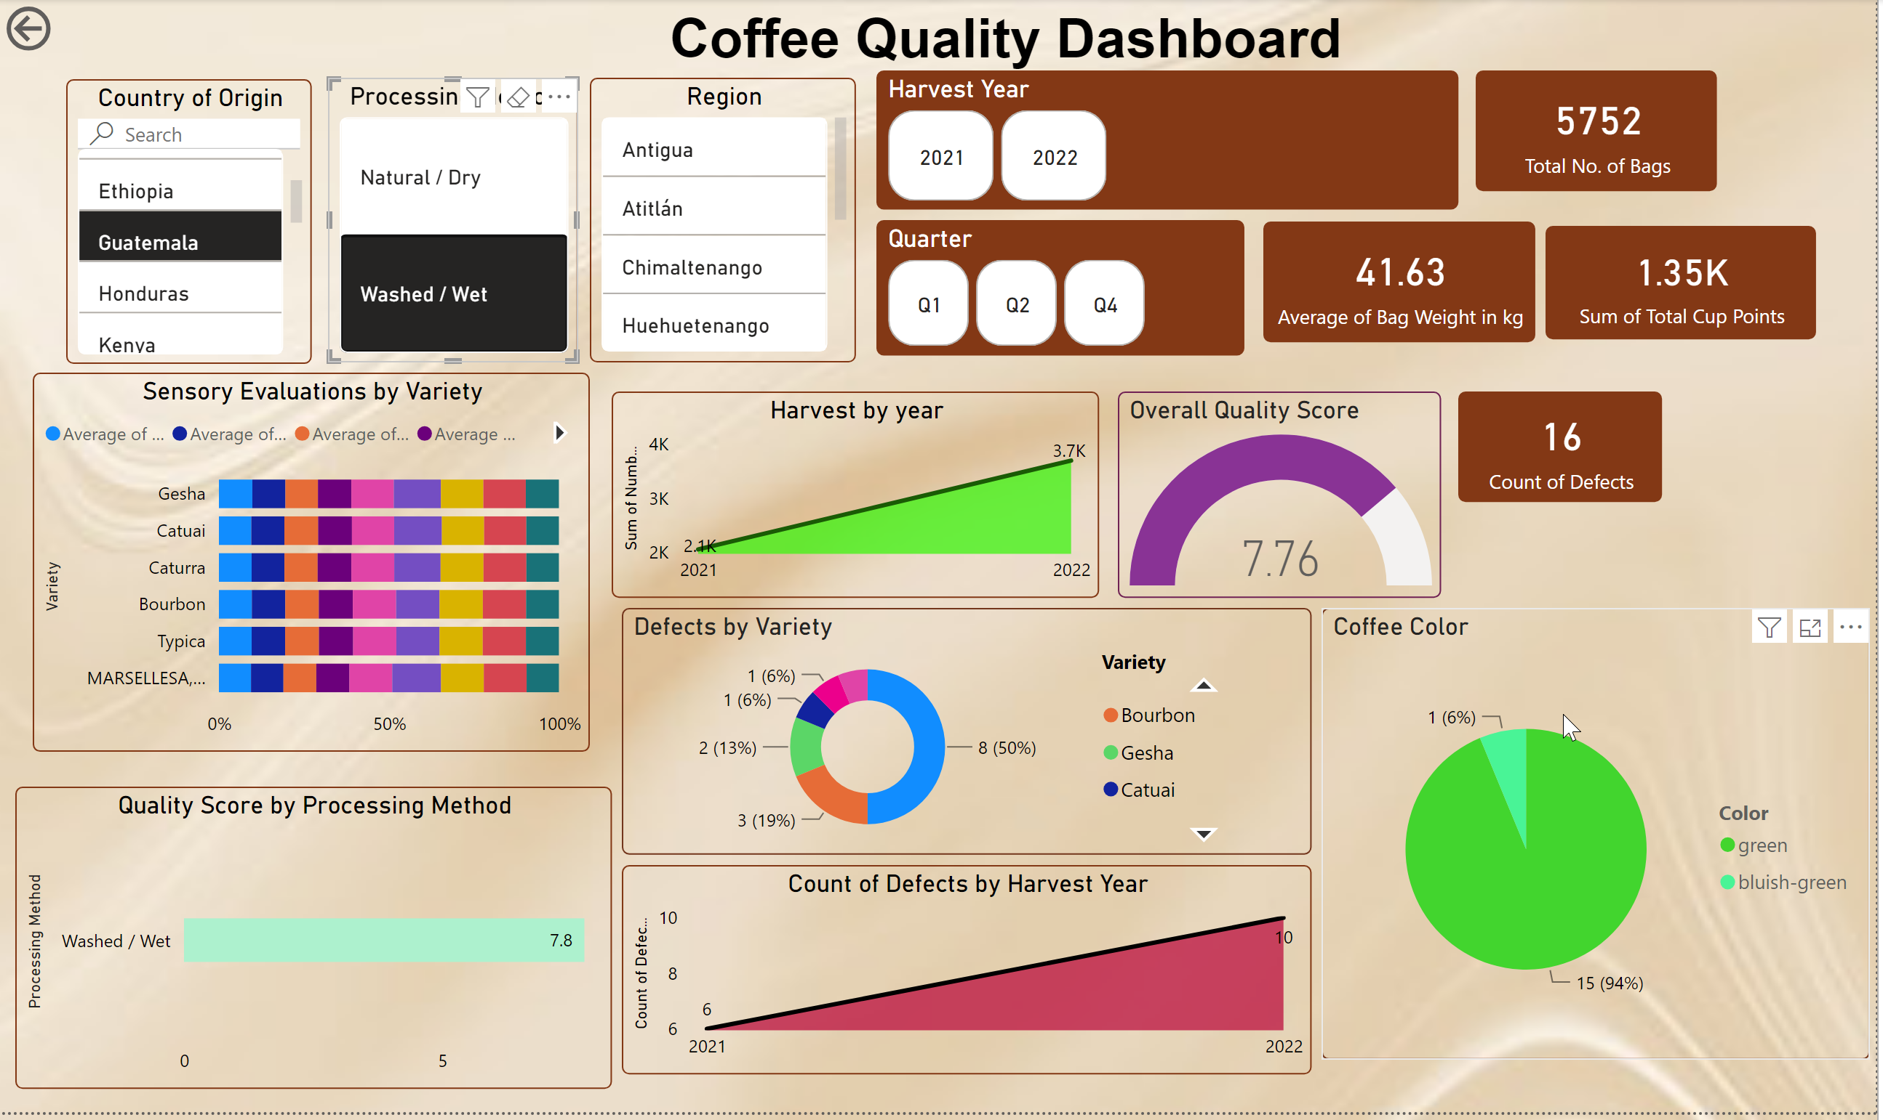
Filters by Country and Processing Method
These filters allow users to drill down into specific subsets of the data based on the country of origin and the processing method used.

Slide 4
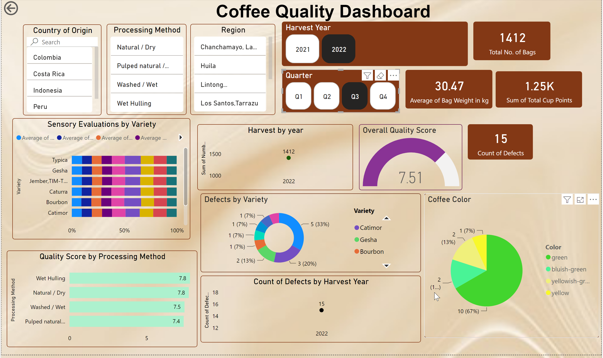
Filters by Harvest Year and Quarter
The Harvest Year and Quarter filters help in analysing trends over time, providing insights into the seasonality and yearly changes in coffee quality.

Slide 5
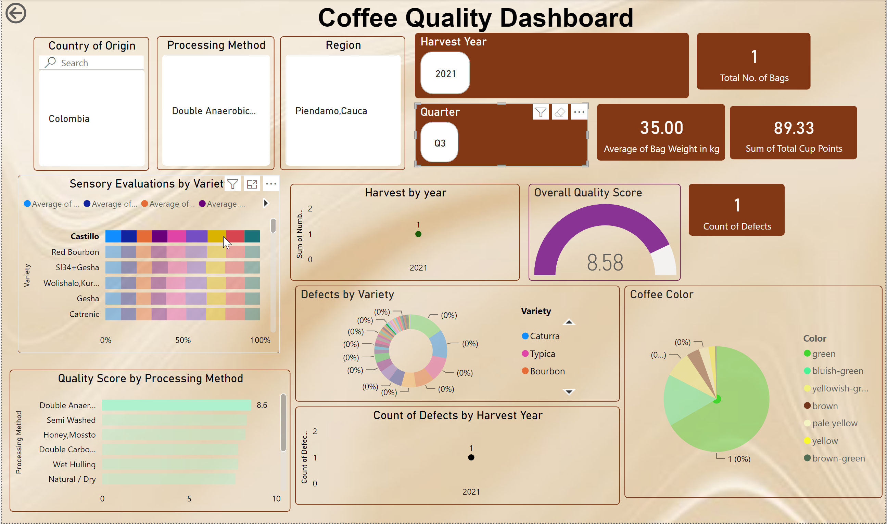
Sensory Evaluations by Variety
This chart provides insights into different sensory attributes for various coffee varieties, allowing for comparison of sensory profiles.

Slide 6
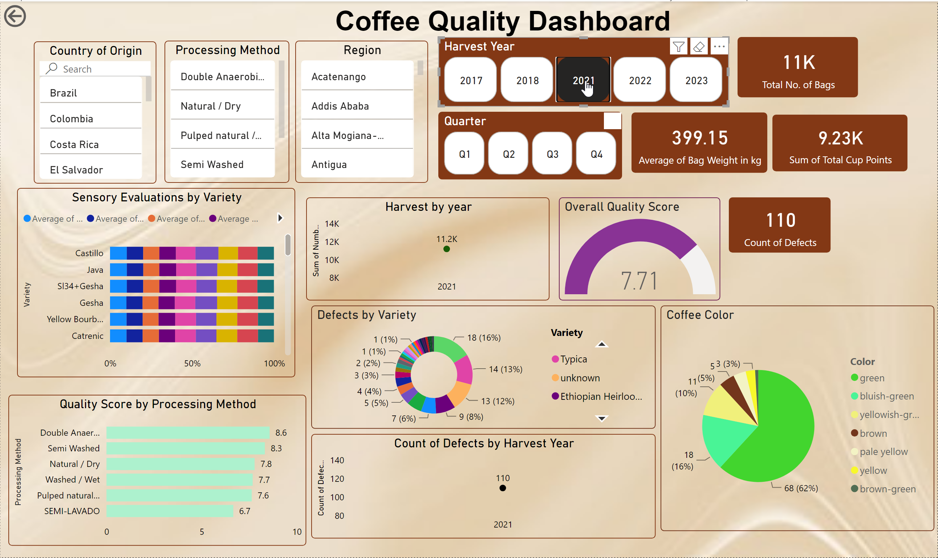
Harvest by Year
This chart shows the harvest data over different years, helping identify trends and patterns in coffee production.

Slide 7
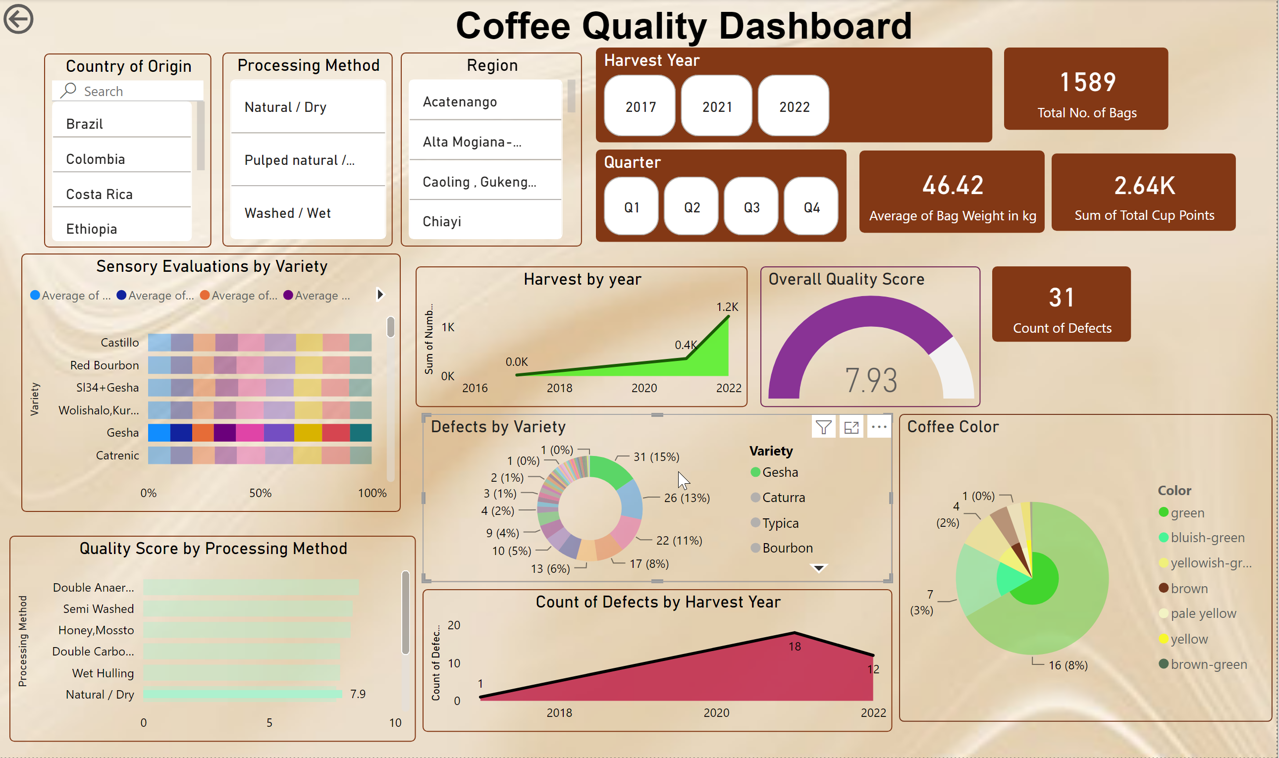
Defects by Variety
The distribution of defects across different coffee varieties is visualized in this chart, providing insights into quality issues.

Slide 8
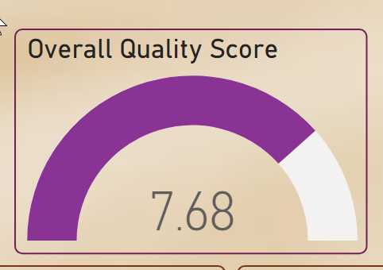
Overall Quality Score
The overall quality score gauge highlights the average quality score of the coffee samples analyzed.

Slide 9
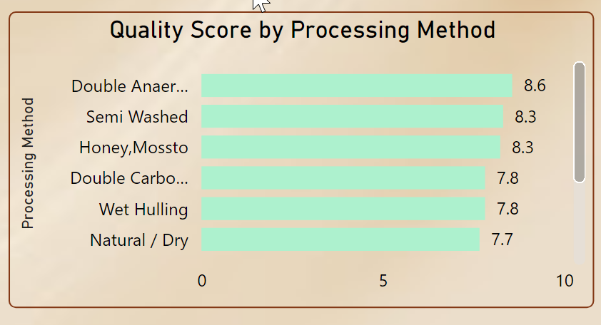
Quality Score by Processing Method
This chart shows how different processing methods impact the quality score of coffee.

Slide 10
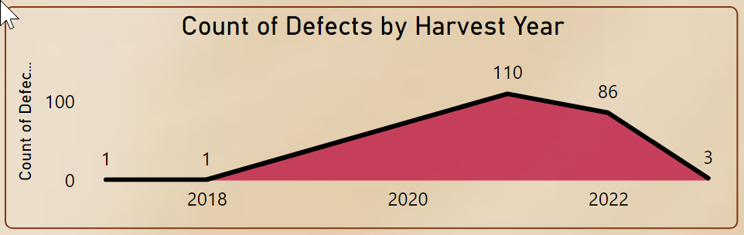
Count of Defects by Harvest Year
This chart shows the trend of defects over the years and potential reasons for these trends.

Slide 11
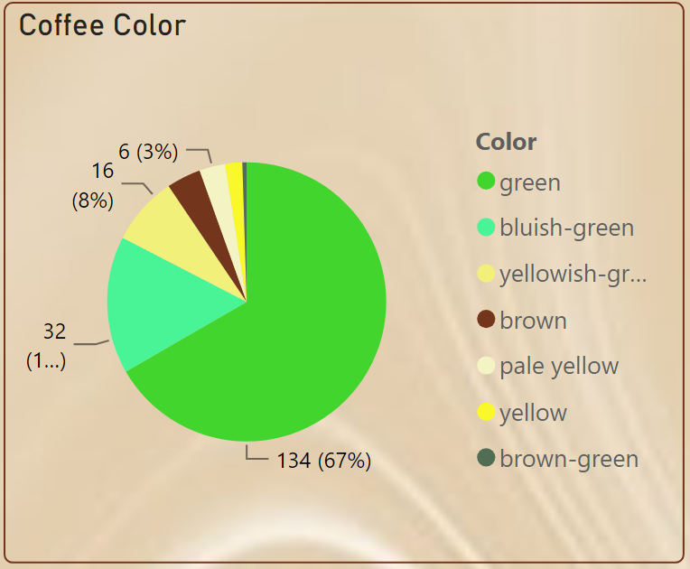
Coffee Color Analysis
This chart shows the distribution of coffee colors and their significance in quality evaluation.

Slide 12
Conclusion
The Coffee Quality Dashboard provides key insights into various aspects of coffee quality including sensory evaluations, defects, and overall quality scores. These insights can help in making informed decisions for improving coffee quality.

